Slide 1
HSA Architecture AND MORE … PLEASE Do NOT FORWARD
November 7th 2012
Antonio Asaro v0.051

Slide 2
Agenda
HSA overview
Value proposition
Example use case – Viola-Jones face recognition method
Simple “HSA program” by yours truly
HSA bit and pieces
Software stack
User Queues + Memory Queue Descriptor(MQD) + Hardware Queue Description(HQD) + Doorbells
GFX ordering + coherency model
HSA Kaveri (GARLIC/ONION+) vs. Carrizo (ONION3)
IOMMUv2 feature set overview (memory translation, interrupt remapping)
ATS (and ATC/IOTLBs) overview
PCIe & OpenCL atomics
GPU HW Virtualization
SOC15 overview → another time maybe?
Caveat– I grabbed slides/diagrams from where I could (from Phil Rogers, Mark Fowler, Bill Hughes, Andy Kegel, Mike Mantor, Ben Sander, Paul Blinzer, Jeffrey Cheng, … and even me) in order to try to get the various concepts across but, be aware, they’re probably out-of-date.

Slide 3
AGENDA - HSA OVERVIEW
HSA overview
Value proposition
Example use case – Viola-Jones face recognition method
Simple “HSA program” by yours truly
HSA bit and pieces
Software stack
User Queues + Memory Queue Descriptor(MQD) + Hardware Queue Description(HQD) + Doorbells
GFX ordering + coherency model
HSA Kaveri (GARLIC/ONION+) vs. Carrizo (ONION3)
IOMMUv2 feature set overview (memory translation, interrupt remapping)
ATS (and ATC/IOTLBs) overview
PCIe & OpenCL atomics
GPU HW Virtualization
SOC15 overview → another time maybe?
Caveat– I grabbed slides/diagrams from where I could (Phil Rogers, Mark Fowler, Bill Hughes, Andy Kegel, Mike Mantor, Ben Sander, Paul Blinzer, Jeffrey Cheng, me …) in order to try to get the various concepts across but, be aware, they’re probably out-of-date.

Slide 4
HSA Value PROPOSITION
Make GPUs easier to program
Improve platform performance and power
Enable GPUs to solve new problems
Improve quality of service
Notes:
Introduction: Market drivers for the HSA architecture:
The computational capabilities for GPUs have grown at a rate greatly exceeding that of the corresponding CPU platforms. This growth, coupled with the explosion of the mobile computing market and the quality of user experience that GPUs provide, has pushed GPU technology to be a volume technology similar to x86 CPUs.
Industry has shifted from a focus on single-threaded performance to multi-threaded performance as we have hit the memory and power walls. The growth in parallelism can be witnessed in multiple ways. In the CPU realm, this discontinuity manifests itself in the
growth of multi-core CPUs. In the GPU realm, it manifests itself in a dramatic increase in the number of SIMD vector units in the GPU. As the degree of concurrency increases, the demand on memory bandwidth and communication latency increases. Although memory bandwidth has improved, it is on a much less aggressive curve than the compute throughput it must serve. Similarly, as the number of compute cores increases, the latency for them to intercommunicate and collaborate to do work becomes more of a hurdle.
Power-constrained, high density computation is a realm where GPUs excel. GPUs deploy advanced techniques to optimize the use of memory bandwidth and to hide latency and offers exemplary performance per dollar and performance per watt.
Unfortunately, some of this gain comes at the cost of making the GPU more difficult to program. HSA is targeted at removing the programmability barrier, reducing the latency of communication between CPU and GPU, and opening up the GPU as a programming platform for a wider range of applications.
The most significant driving force behind the growth of the GPUs is the growth of mobile and consumer-oriented devices. In this
space, product value is equal to the user experience that a device provides. The focus on compute for the consumer combined with ubiquitous network connectivity has fueled a corresponding growth in media rich applications. This is where GPUs excel. They are optimized for the computing needs of such environments. However, due to fact that GPUs do not have as rich a programming ecosystem as CPUs, their use has been limited to 3D graphics and a few leading edge multimedia applications, which are already accustomed to dealing with graphics and video APIs. HSA is an enabler to extend the GPU a to wider range of applications and environments and unleash true heterogeneous computing.
The core of the HSA strategy is to create a unified single programming platform to provide a strong foundation for development in languages, frameworks, and applications that exploit parallelism. HSA will enable a single application to be written so that it runs on a wide range of platforms using both the GPU and CPU components.
The goals of the HAS architecture are:
Easier to program : Close to how developers program multi-core CPUs today.
Platform perf and power : Remove copies and others.
New Problems : Beyond simple gridded matrix multiplies
Improve Quality of Service : Pageable virtual memory and context switching.

Slide 5
Enable GPUs to solve new problems
Leverage heterogeneous compute resources
Use both CPUs and GPUs, where appropriate
Closer CPU/GPU integration and unified address space increases appeal
Provide automated load-balancing
Kernel can enqueue work to any other device in system
GPU->GPU, GPU->CPU
Allows HSA apps to solve broader class of problems
Beyond classic grid-based computation
Task-graph style algorithms, Ray-Tracing, etc
Key takeaway: AMD HSA defines a unified address space across the CPU and the GPU devices. All HSA devices will support virtual address translation: a pointer can be freely (w/o copy) passed between devices and HSA will ensure that the virtual address pointers resolve to the same physical address. “Ptr-is-a-ptr” concept.
Notes:
Unified Address Space (explain what are the problems unified address space is resolving):
AMD HSA defines a unified address space across the CPU and the GPU devices. All HSA devices will support virtual address translation: a pointer can be freely passed between devices and HSA will ensure that the virtual address pointers resolve to the same physical address. In the HSA-compliant system, the unified address space includes discrete GPU devices in addition to Fusion devices.
To enable the unified address space, AMD's IOMMUv2 supports full x86 page tables to allow x86 user code and GPU user code to share the same page tables. Each GPU context corresponds to a standard x86 user (or supervisor) context, and each GPU context participates fully in paging translations and protections.
The unified address space removes the need for the programmer to copy data between different device memory spaces programmers can simply pass pointers back and forth without concern for device boundaries. Programmers need not write the copy code, nor debug the failures when the copies are coded incorrectly. Additionally, removing the copies improves performance by reducing memory bandwidth consumption and avoiding busying devices with copying. Moreover, this feature removes the need for the compute kernel to be specifically aware where it will execute - compute kernels can be dynamically scheduled onto the available CPU or GPU devices in the system.
Finally, the unified address space allows both the CPU and the GPU to access a single large address space. This is a substantial improvement from today's discrete GPU devices which can typically only address the memory on the graphics board, which is a fraction of the total memory available in the system. As a specific example, a 2010 high-end GPU can address only 2GB of memory while a high-end CPU system typically has 8GB or more of physical memory. For many realistic problem sizes, GPGPU programmers have to partition the problem to t in the limited discrete address space and suffer the performance from copying the relevant data between the address spaces to swap the different parts of the problem. HSA will remove this burden and improve performance.
Program-visible Coherence Properties (explain what are the problems coherent memory model is resolving):
AMD HSA provides a coherent memory model for all HSA heaps. For example, the CPU can write to a block of memory and then access that memory from the GPU device, without having to explicitly synchronize or flush the caches to make the write visible. Likewise, CPU accesses are coherent with the GPU writes. Coherency enables HSA to generate the correct answer even when the task is executed by different
devices in the system. Coherency allows the system to support fine-grained communication between devices without requiring heavy-weight explicit cache flushes and synchronization operations.
Queuing and the HSA Library:
HSA includes a library which supports the interface between the task parallel language and the underlying HSA devices. Most developers will not call these functions directly; rather, they will code in a task programming language or task programming extension, and the task programming library will make calls into the HSA library for:
Device discovery
Device performance profiling (the performance characteristics of the available FSA devices)
Memory Allocation. HSA libraries support allocation into the deferent heaps supported by FSA.
Queue mechanics, including functions for enqueuing tasks from the CPU to the GPU device.
Notification: Detecting when a task has completed on the GPU and polling facilities
Debugging and Profiling

Slide 6
Heterogeneous Pipeline
Mimics a traditional manufacturing assembly line
Developer supplies a series of pipeline stages
Each stage processes it’s input token, passes an output token to the next stage
Stages can be either CPU-only, GPU-only, or CPU/GPU
CPU/GPU tasks are dynamically scheduled
Use queue depth and estimated execution time to drive scheduling decision
Adapt to variation in target hardware or system utilization
Data location not an issue in HSA
Leverage single source code
GPU kernels scheduled asynchronously
Completion invokes next stage of the pipeline
Simple Video Pipeline Example:
Video Decode (CPU-only)
Video Processing
(CPU/GPU)
Video Render (GPU-only)
Notes:
Key Points: * Developer supplies a GPU and a CPU implementation of the algorithm
* Kernels written in OpenCL or C++ AMP – does it matter?

Slide 7
HSA Workflow
Work-Stealing
Q
Q
Q
Q
Q
CPU
Worker
CPU
Worker
CPU
Worker
CPU
Worker
GPU Manager
Mem
CP
Key:
CPU Threads
S
I
M
D
S
I
M
D
S
I
M
D
S
I
M
D
GPU Threads
…
Memory

Slide 8
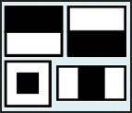
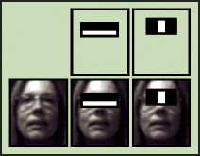
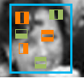
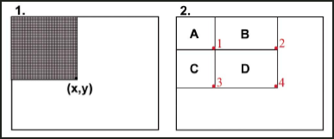
HAAR Cascade stages
HAAR FEATURES
Feature k
Feature l
Stage N
INTEGRAL IMAGE
Feature m
Face still possible?
Yes
Feature p
No
Feature r
Stage N+1
Feature q
REJECT FRAME
Notes:
http://www.cognotics.com/opencv/servo_2007_series/part_2/sidebar.html
OpenCV's face detector uses a method that Paul Viola and Michael Jones published in 2001. Usually called simply the Viola-Jones method, or even just Viola-Jones, this approach to detecting objects in images combines four key concepts:
Simple rectangular features, called Haar features
An Integral Image for rapid feature detection
The AdaBoost machine-learning method
A cascaded classifier to combine many features efficient
The features that Viola and Jones used are based on Haar wavelets. Haar wavelets are single wavelength square waves (one high interval and one low interval). In two dimensions, a square wave is a pair of adjacent rectangles - one light and one dark.
The presence of a Haar feature is determined by subtracting the average dark-region pixel value from the average light-region pixel value. If the difference is above a threshold (set during learning), that feature is said to be present.
To determine the presence or absence of hundreds of Haar features at every image location and at several scales efficiently, Viola and Jones used a technique called an Integral Image. In general, "integrating" means adding small units together. In this case, the small units are pixel values. The integral value for each pixel is the sum of all the pixels above it and to its left. Starting at the top left and traversing to the right and down, the entire image can be integrated with a few integer operations per pixel.
Simple rectangular features, called Haar features
An Integral Image for rapid feature detection
The AdaBoost machine-learning method
A cascaded classifier to combine many features efficiently

Slide 9
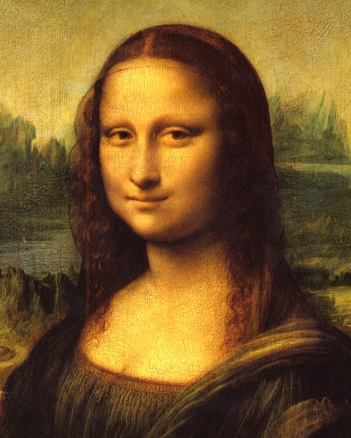
Cascade Depth Analysis

Slide 10
Processing Time/Stage
AMD A10 4600M APU with Radeon™ HD Graphics; CPU: 4 cores @ 2.3 MHz (turbo 3.2 GHz); GPU: AMD Radeon HD 7660G, 6 compute units, 685MHz; 4GB RAM; Windows 7 (64-bit); OpenCL™ 1.1 (873.1)
Notes:
Here we see what happens as more and more work items exit on each cascade stage.
In the first stage, the GPU is fully loaded and more than 5 times as fast as the CPU.
For the next few stages, it is close, and the CPU is clearly better at the latter stages.
How best to run this workload?
Run early stages on the GPU, and later stages on the CPU
Run each workload where it is most power efficient!
HSA allows this since we are in shared coherent memory

Slide 11
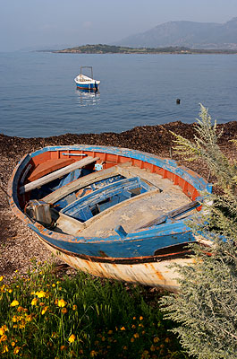

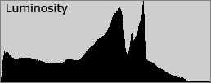
SIMPLE “HSA Program” in “ANTONIO C++”
#include “HSA_libs.h”
volatile integer all_done = 0; // FLAG
HSA_alloc(integer histogram[255:0], `HSA_SHARED); // DATA
// CPU executes task parallel operations
begin
if … then … else …
for i {histogram[i] = 0; }
load(image, from_file, “image.jpeg”, rgb);
gpu(image, histogram);
while (!all_done) {};
print_nicely(histogram);
exit(0);
end
// GPU executes data parallel operations
begin
for each pixel begin // Luminosity algorithim
y = image[pixel].R*0.3 + image[pixel].G*0.59 + image[pixel].B*0.11; // Shader kernel → compiled to HSAIL
fetch_and_Add(histogram[y], +1); // Shader kernel
// barrier (); // Shader kernal
if (pixel == 0) all_done = 1; // Shader kernel
end
end

Slide 12
Agenda – HSA BITs AND PIECES
HSA overview
Value proposition
Example use case – Viola-Jones face recognition method
Simple “HSA program” by yours truly
HSA bit and pieces
Software stack
User Queues + Memory Queue Descriptor(MQD) + Hardware Queue Description(HQD) + Doorbells
GFX ordering + coherency model
HSA Kaveri (GARLIC/ONION+) vs. Carrizo (ONION3)
IOMMUv2 feature set overview (memory translation, interrupt remapping)
ATS (and ATC/IOTLBs) overview
PCIe & OpenCL atomics
GPU HW Virtualization
SOC15 overview → another time maybe?

Slide 13
HSA Solution Stack
Application
Domain Specific Libs
(Bolt, OpenCV™, … many others)
Application
SW
OpenCL™ Runtime
DirectX
Runtime
Other Runtime
HSA
Software
HSA Runtime
Legacy
Drivers
UMD + KMD
Doorbells
HSAIL
Ctl
Drivers
HSA Finalizer
KFD Driver
HW
GPU ISA
Legacy PM4
CPU(s)
GPU(s)
Other Accelerators
Notes:
With HSA, there is an alternate path to the accelerators in the system, besides the legacy driver model.
We are moving beyond the platform architecture of the last 25 years, to unlock software innovation for modern workloads.
Applications will be able to deliver work *directly* to the queues fetched by the parallel processor in the GPU.
We abstract the parallel processor with a new virtual ISA, called HSAIL. A low level IL that allows multiple hardware vendors to continue to innovate within a standard platform. There is a “finalizer” between the HSAIL generated by the high level compiler and the GPU ISA. The architecture supports the finalizer being run at multiple possible times: at run time, install time or compile time, depending on the target platform.

Slide 14
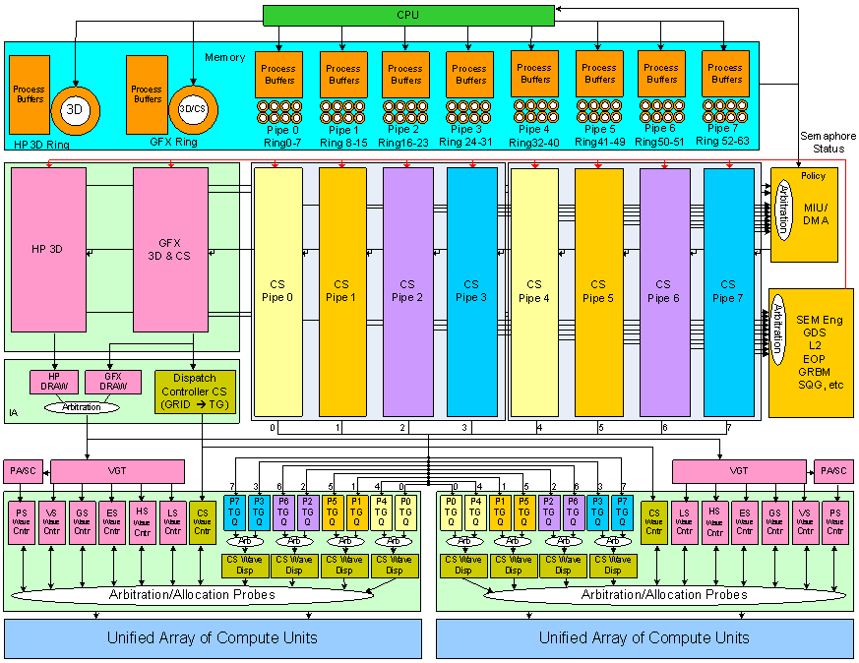
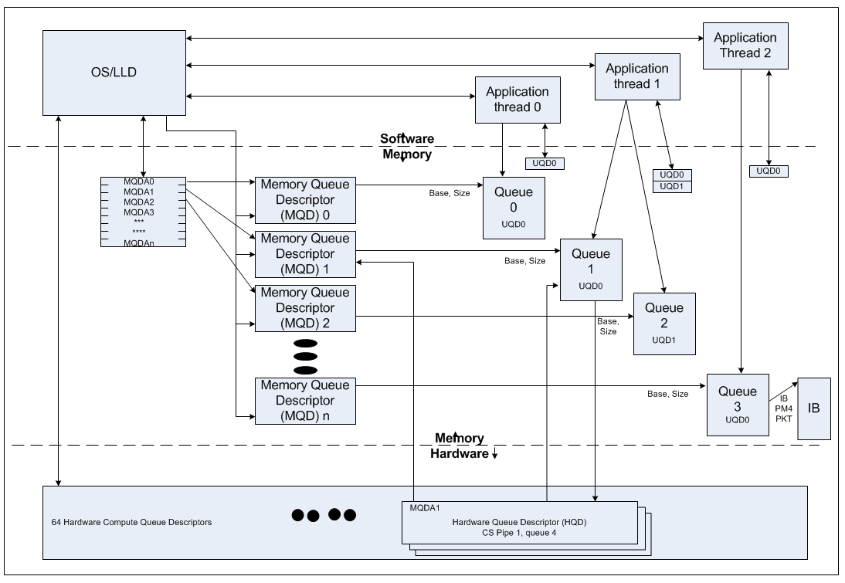
HSA USER QUEUES + MQD + HQD + DOORBELLS

Slide 15
MeMORY Consistency/ORDERING fOR SMP
FSA GPU is optimized for “weak” consistency memory model
A single thread is always self-consistent (SC) so no fence required for self-consistency
Anywhere two ops are re-ordered, then a fence between the ops is required if order is desired
Example of store<>store reorder and/or load<>load reorder. Initial conditions *A=*B=0
CU0 CU1
*A=1 R0=*B
*B=1 R1=*A
Due to weak consistency, we can get R0=1 and R1=0, either because the stores in CU0 are reordered, or the loads in CU1 are reordered. A fence op is required between the two stores and another between the two loads in a weakly consistent model to guarantee R1==1 when R0==1.

Slide 16
Acquire/Release Applied to Weak Consistency HW
When a thread is working on shared data between threads it must “acquire” the shared data
A thread must “release” data when completed working on shared data
“Acquire” Operation requirements
Guarantee all subsequent data access operations
occur after the acquire operation
are to coherent / released data
“Release” Operation requirements
Guarantee all previous data access ops
occur prior to the release operation
are equally visible to all other threads (coherent)

Slide 17
Acquire/Release Implementation
Uses “synchronization” variables
ex. Java->”volatile”, C++0x->“atomic”
Accesses to sync variables are always sequentially consistent and coherent
Release is “store_release” of a sync variable
fence – make sure all prior memory ops have completed and are visible to other threads (inflight memory ops == 0)
store - store the sync variable w/ guaranteed visibility to other threads (coherent)
Acquire is “load_aquire” of a sync variable
load - load sync variable from global coherent memory
fence
In actual usage “cas_release” and “cas_aquire” may be more prevalent (spin-lock)

Slide 18
CC MemoRY – KAVERI + CarriZO w/ gL2 Cache COHERENCE
GPU L1 used as read cache + write-combining
For Carrizo …
For CC memory, gL2 participates in cache coherence protocol w/ the CPU on the Onion3 bus (cHT – coherent hypertransport protocol)
Meaning gL2 accepts probe requests when CPU misses its L2
gL2 is not a full MOESI participant w/ the CPU caches and does “SI” protocol only
“S” – Cache block in a shared state
“I” – Cache block invalid
Only read requests to the TCC can install a cache block in the “S” state in the gL2 and all writes and atomics to “CC” space will bypass the cache entirely
GRUB needs to know the difference between CC memory requests and all other memory requests. This is “shared” bit on the TCC<>GMC request interface

Slide 19
GFXIP8 – APU Interconnect CHANGES
CP
IA(s)
VGT(s)
SQC(s)
TCP(s)
CP
IA(s)
WD
SQC(s)
TCP(s)
Xbar (via TCI/TCP)
Xbar (via TCI/TCP)
HUB
gL2 (TCC)
TCS
gL2 (TCC)
GMC
CHUB
GMC
probe
Onion (ncHT)
Garlic
Onion+(ncHT w/ atomics)
GRUB
UNB
Onion3 (cHT w/ atomics)
L2
L2
UNB
CPU
CPU
L2
L2
CPU
CPU
Kevari / Thebe
Carrizo
* DB/CB <> GMC, and thread trace <> HUB connections not shown
Notes:
So in Kaveri/Thebe, gL2 was private cache. In CZ, gL2 becomes part of the coherence protocol on Onion3. Please explain the problem and advantage gained with this big step, e.g. what we had to do in Kaveri/Thebe due to the gL2 being a private cache and what are we gaining in CZ with this big advance in gL2. Are slides on Pages 30-32 meant for it?

Slide 20
KAVERI fusion interconnect
CPU0
CPU1
CPU0
CPU1
L2
L2
CCI
Garlic path bypasses coherence check (MCT/SRQ)
NBSYN
Current onion path subject to multiple BW bottlenecks
NBSYN
SRQ
Onion bw doesn’t scale with dram
MCT
DCT
DDR PHY
D3/G5
XBAR
DCT
DDR PHY
D3/G5
DCT
DDR PHY
D3/G5
NB
LNK
NB
LNK
DCT
DDR PHY
D3/G5
Garlic bandwidth scales with DRAM bandwidth
onion+
garlic
sync
sync
Current interconnect has several issues :
- garlic bw scales well, but coherent bw (onion) doesn’t
- requires support for two different busses/protocols
- increasing onion bw would means the total is over-provisioned
- it’s going to get even harder with chip stacked DRAM (higher bw))
ORB
CHUB
GMC
GFX
IOC
gBIF
UVD
DCE

Slide 21
CARRIZO FSI probe flow (CPU req)
1. CPU-A issues cacheable read to MCT
2. MCT issues probe to GPU
MCT issues probe to CPU-B
MCT issues read to DRAM (not shown)
3. GPU response goes back to MCT.
4. DRAM rsp, CPU-B rsp collected by SRQ
5. Data return to CPU-A when all responses received
Note : Slow GPU prb resp would affect CPU latency
CPU0
CPU1
CPU0
CPU1
L2
L2
CCI
Probe CPU L2
NBSYN
NBSYN
SRQ
CPU read
MCT
DCT
DDR PHY
D3/G5
XBAR
DCT
DDR PHY
D3/G5
DCT
DDR PHY
D3/G5
DCT
DDR PHY
D3/G5
NB
LNK
Mini-xbar
Probe GPU L2
onion2.0
(legacy)
onion3.0
ORB
GRUB
gBIF
GMC
Note: GRUB assumes the probe completes at the GPU L2 and short-circuits the response.
GPU L2 invalidates cacheline on a probe (regardless of the type).
IOC
GC+L2

Slide 22
CARRIZO FSI probe flow (GPU req)
1. GPU issues cacheable read to MCT
2. MCT issues probe to CPUs
MCT issues read to DRAM (not shown)
3. SRQ sends prb rsp to MCT (for all CPUs)
4. DRAM rsp, optional Prb rsp collected by GMC
5. Data returned to GPU when Dram data is available.
- If probe response beats Dram, dirty data will
be returned instead of stale dram data. Similarly,
if the probe is clean, a single response with Comp
bit set will be sent.
- If probe response lags Dram, dirty data will be returned separately. If it is clean or miss, probe
response will be sent separately
Note : Poor CPU prb throughput would affect GPU bw
CPU0
CPU1
CPU0
CPU1
L2
L2
CCI
Probe CPU L2
NBSYN
NBSYN
SRQ
CpuPrbRsp
MCT
DCT
DDR PHY
D3/G5
XBAR
DCT
DDR PHY
D3/G5
DCT
DDR PHY
D3/G5
DCT
DDR PHY
D3/G5
NB
LNK
Mini-xbar
onion2.0
(legacy)
onion3.0
ORB
GRUB
IOC
gBIF
GMC
GC+L2
1. Note: GRUB can issue probes into the GPU L2 for CC writes from clients that don’t go thru the GPU L2 – e.g. sDMA.
Notes:
Onion3 supports read responses in the downstream direction only.
Two read responses, or a read response and a probe response, may be returned in response to an upstream read request. If two read responses are received, one will be from DRAM (carrying stale data) and one from the node‟s caches (carrying true data); the Probe bit will be set in the read response carrying the true data.
If a read response is received with its Comp bit set, the response is complete; there will not be an additional read or probe response sent downstream for this read request.

Slide 23
IOMMU - Usage Models
IOMMUv1 (RD890)
RAS
Driver Containment
Virtualization
OS/Application Containerization
Interrupt Steering
Interrupt Denial of Service Protection
IOMMUv2 (Trinity)
Hypervisor Memory Over-commit
User-level IO & Compute Offload ← HSA MMU
Direct Guest Interrupt Delivery ← AVIC
Notes:
Please explain the motivation for the IOMMU, the problems it resolves and the value it provides.

Slide 24
IOMMU - TERMINOLOGY
IOMMU/TA
IOTLB/ATC
PCIe-ATS
Translation Request/Translation Response
Invalidate Request/Invalidate Response
AT field [1:0]
00 = Untranslated
01 = Translation Request
10 = Pre-translated

Slide 25
THE IOMMUv2 Location in the system
“Upstream” of the I/O devices
“Downstream” of the Memory Controller
Therefore the IOMMUv2 can process all IO DMA operations

Slide 26
IOMMUv2 – Memory Structures
Peripheral page service requests (PRI)
Guest CR3 table
AMD64 long page tables (guest)
IOMMU page tables (host)
IOMMUv1 base
IOMMUv2 changes

Slide 27
IOMMUv2 – Guest and Host PTE
Guest
Host
Deltas
4KB, 2MB, 1GB vs. Variable Page Sizes
Level Skipping
Accessed & Dirty bits (requires ISOC atomics)
Guest format
Host format

Slide 28
IOMMUv2 – Nested Paging
Notes:
Please explain how applications run in gVa space, the Guest OS in guest physical address space and Hypervisor in System physical address space and how we move from gVa -> gPa ->sPa by having IOMMUv2 support nested paging.

Slide 29
IOMMUv2 -Translation models
GVA – guest virt. addr
GPA – guest phys. addr
SPA – system phys. addr
Peripheral A
Peripheral B
Peripheral C
GVA=GPA
GVA-to-GPA
GVA-to-GPA
GPA-to-SPA
GPA=SPA
GPA-to-SPA
System memory
System memory
System memory
IOMMUv1
OS & peripheral can share x86 page tables
IOMMUv2 (full)

Slide 30
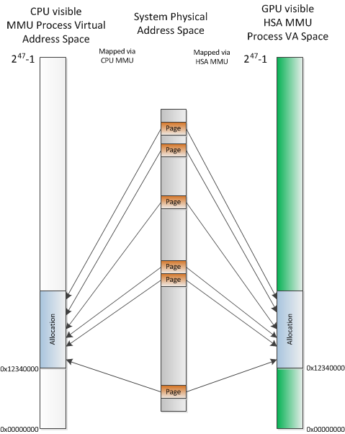
Using it as HSA MMU
HSA MMU functionality allows system software to provide a device the same view of the user mode process address space as for the CPU
Process page tables are shared with or mirrored by the OS
An HSA compliant device (e.g. GPU) can execute instructions using pointers passed from the CPU and vice versa
And access system memory with the same virtual address
“ptr-is-a-ptr”
HSA MMU will detect and block accesses of the device outside of the address ranges allocated/granted by the system software
System software receives a page fault if the device address is not available in memory
If the virtual memory address is currently “paged out”, system software brings page content from storage into physical memory and the device continues
If the virtual memory address is not allocated by the process an “access violation” error is raised, similar to what happens on the CPU

Slide 31
IOMMUv2 - Peripheral page faults (PPR or PRI)
IOMMU
CPU
RAM
Peripheral (ATC)
IOMMU
ATS request
Page tables
ATS response
Evaluate ATS response
PRI request
Software policy
Swap in page
Alloc new page
Reject request
Upgrade privs
Copy-on-write
etc.
PPR queue
SW
CMD queue
PRI response
Evaluate PRI response
ATS request
Event log
ATS response
Time
Notes:
ATS – Address Translation Services (PCI interface)
PRI – Page Request Interface (PCI interface)
PPR – Peripheral Page Request (IOMMU interface)
CMD – Command queue (IOMMU interface)
Event – Event log (IOMMU interface)
RAM – system memory
SW – software (operating system or hypervisor)
Servicing of page faults (and other memory faults) encountered by the GPU is requested via the IOMMUv2.
The system-level sequence of steps in servicing a GPU page fault is as follows:
1. GPU detects TLB miss
2. GPU sends translation (ATS) request to IOMMUv2
3. IOMMUv2 sends ATS response to GPU
4. If ATS response indicates a translation failure:
(a) GPU sends fault handling (PRI) request to IOMMUv2
(b) IOMMUv2 triggers fault handling request to IOMMUv2 driver
(c) IOMMUv2 driver requests fault handling from OS memory manager
(d) OS performs necessary steps to handle fault
(e) OS signals fault handling completion to IOMMUv2 driver
(f) IOMMUv2 driver signals IOMMUv2 of fault handling completion
(g) IOMMUv2 sends PRI response to GPU
5. GPU sends translation (ATS) request to IOMMUv2
6. This time around page is there, and IOMMUv2 sends the translated page back to the GPU.

Slide 32
IOMMUv2 - GPU Double Copy Example
Why?
Not all GPU memory is CPU accessible
Local frame buffer may not be big enough
Lack of demand-paging support
Alignment limitations
How?
Data copied from an unpinned to pinned regions
GPU DMA data into a larger frame buffer region
What do we want?
Eliminate CPU & DMA copy operations (in both directions!!)
GPU operates on unpinned region directly
CPU Copy/OS call
GPU DMA
Unpinned Memory
Pinned Memory
Local Frame Buffer
GPU
Unpinned Memory
GPU
IOMMUv2

Slide 33
sDMA ATC exAMPLE
sDMA supports HSA

Slide 34
CU ATC XACK/XNACK

Slide 35
PCIe Atomics
Adds 3 opcodes
FetchAdd (Fetch and Add): Request contains a single operand, the “add” value
Read the value of the target location
Add the “add” value to it using two’s complement arithmetic ignoring any carry or overflow
Write the sum back to the target location
Return the original value of the target location
Swap (Unconditional Swap): Request contains a single operand, the “swap” value
Read the value of the target location
Write the “swap” value back to the target location
Return the original value of the target location
CAS (Compare and Swap): Request contains 2 operands, a “compare” value and a “swap” value
Read the value of the target location
Compare that value to the “compare” value
If equal, write the “swap” value back to the target location
Return the original value of the target location
Support based on operand size:
Capability bit to indicate Completer supports FetchAdd32, Swap32, CAS32
Capability bit to indicate Completer supports FetchAdd64, Swap64, CAS64
Capability bit to indicate Completer supports CAS128
Notes:
Please, if possible, explain which advances synchronization mechanism PCIe Atomics are resolving.
More generally the atomics on gpu enables the use of shared data structures in shared memory between different work-items! The use of atomics also enables more efficient usage of shared memory in a heterogenous system between accelerator threads and scalar threads! Things like allocation and enqueue/de-queue, message passing and so forth! Locks that are enabled with simple fabric atomics are really a way to enable more advanced atomics! For instance, simple allocation requires multiple atomics, is the space, and if so remove space, and advance a pointer without being interrupted.
There are lots of usages of atomic ops, histogram (add) for example. Cmpswap is probably the most common usage for locks etc…
http://www.informit.com/guides/content.aspx?g=cplusplus&seqNum=469

Slide 36
OpenCL Base Atomics (int32)
Function | Meaning | PCIe Mapping
atom_add(int* p, int val) atom_add(unsigned int* p, unsigned int val) | old = *p *p = *p + val return old | FetchAdd32(p, val)
atom_sub(int* p, int val) atom_sub(unsigned int* p, unsigned int val) | old = *p *p = *p – val return old | FetchAdd32(p, -val)
atom_xchg(int*p, int val) atom_xchg(unsigned int*p, unsigned int val) | old = *p *p = val return old | Swap32(p, val)
atom_inc(int* p) atom_inc(unsigned int* p) | old = *p *p = val + 1 return old | FetchAdd32(p, 1)
atom_dec(int* p) atom_dec(unsigned int* p) | old = *p *p = *p – 1 return old | FetchAdd32(p, -1)
atom_cmpxchg(int* p, int cmp, int val) atom_cmpxchg(unsigned int*p, unsigned int cmp, unsigned int val) | old = *p *p = (old == cmp) ? val : old return old | CAS32(p, cmp, val)

Slide 37
Agenda – GPU HW VIRTUALIZATION
HSA overview
Value proposition
Example use case – Viola-Jones face recognition method
Simple “HSA program” by yours truly
HSA bit and pieces
Software stack
User Queues + Memory Queue Descriptor(MQD) + Hardware Queue Description(HQD) + Doorbells
GFX ordering + coherency model
HSA Kaveri (GARLIC/ONION+) vs. Carrizo (ONION3)
IOMMUv2 feature set overview (memory translation, interrupt remapping)
ATS (and ATC/IOTLBs) overview
PCIe & OpenCL atomics
GPU HW Virtualization
SOC15 overview → another time maybe?

Slide 38
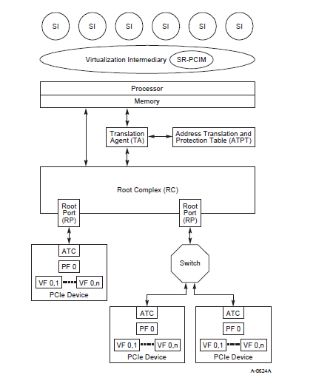
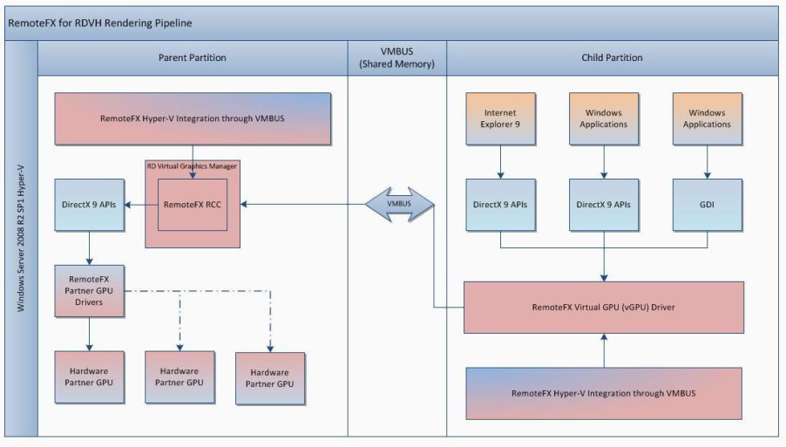
GPU Virtualization - Definitions
SI/VM/OS == A software component running on a virtual system to which specific Functions, PF, and VF can be assigned. Specification of the behavior and architecture of an SI is outside the scope of this specification. Examples of SIs include guest operating systems and shared/non-shared protected domain device drivers.
Virtualization Intermediary (VI/VMM/HV) == A software component supporting one or more SIs–colloquially known as a hypervisor or virtual machine monitor. Specification of the behavior and architecture of the VI is outside the scope of this specification.
SR-IOV == The SR-IOV capability structure is used to discover and configure a PF’s virtualization capabilities. These virtualization capabilities include the number of Virtual Functions (VF) the PCIe Device will associate with a PF and the type of BAR mechanism supported by those VFs. Example device: Intel 82576 1GbE NIC
SR-PCIM == Single Root-PCI Manager → Software responsible for configuration and management the SR-IOV capability and PF/VF as well as dealing with associated error handling.
PF == Physical Function → A PCI Function that supports the SR-IOV capabilities defined in this specification. A PF contains the SR-IOV capability structure
VF == Virtual Function → A “light-weight” function that is associated with a Physical Function. A VF shares one or more physical resources, such as a Link, with the Physical Function and other VFs that are associated with the same PF.
RemoteFX == RemoteFX delivers a full-fidelity user experience for Virtual Desktop Infrastructure (VDI) by providing a 3D virtual adapter, intelligent CODECs, and the ability to redirect USB devices in virtual machines.

Slide 39
GPU Virtualization - Use Cases
Client virtualization
XenClient: may be possible, pending DCE PRS decisions and customer acceptance due to lack of video acceleration. Support 1:1 passthru today
Scenario:
BYOC → “bring you own computer” to work. Hypervisor w/ corporate + personal VM and possibly a development VM
Server Virtualization (today, RemoteFX, VMware – both are SW abstractions)
XenServer, Amazon EC2 cloud server, Microsoft Azure cloud server
Scenarios:
Cloud server
High Performance Computing (HPC)
Remote desktop for knowledge workers (VDI)
Gaming server
Workstation server consolidation
Possibly others
delta → density of users
Client vs. Server delta → display virtualization

Slide 40
Why Hardware Solution?
Software solutions exist, restrictions abound
Limited performance, feature set, security
Software solutions are not economically scalable
Proliferation of virtualization systems and operating systems all need specific software development
(Virtualization architectures) × (Operating systems) = a very large number

Slide 41
GPU Virtualization - SW Architecture
Hypervisor + privileged Host VM + multiple Guest VM’s
VBIOS is responsible for GPU initialization to run HV and Guest VMs.
The HV is 3rd party software (XenClient, Hyper-V, VMware ESX …) so, limit exposure to vendor-specific code. HV uses GPU PCIe config space to control basic GPU functions (e.g. GPU resource allocation, world switch)
Host VM – a privileged partition. May/may not contain a full gfx driver. Whole virtualization system must run without a host VM driver. If host VM has a driver, additional functionality such as desktop composition may be supported. If loaded with a driver, host VM would be assigned to the PF where its driver accesses the GPU via MMIO thru the PF BAR. If supported, the compositing task is a separate thread in the Host VM
Guest VM – HV (via SR-PCIM) assigns a VF to each VM, upto the # of VF’s supported by the GPU. Additional VM’s are supported. These additional VM’s are either a) not accelerated or b) swapped in/out under HV control. Contains a full gfx driver that is mostly unaware of virtualization environment.
VMs have simultaneous access to FB & doorbell ranges. Register range/MMIO access is limited to one VM (Host VM or Guest VMs) at any one time, we use CPU MMU/IOMMU to control access (map/unmap → page faults).

Slide 42
SR–IOV Support
ASIC - Tonga
Support for 16 guest VF/VMs + 1 PF – GPU HW acceleration
Moderate-Density 3D(compute) - only Virtualization
Same Gfx Driver for both PF and VF#
3D Engine usage – one VM at one time
Features
Multimedia – All multimedia content goes to CPU
Support non-DRM content only
Power Management
Basic thermal protection
Basic DPM – not optimized
Some feature restrictions (e.g. FBC, ABM)
VDDGFX -> TDB; relies on auto-scheduling mode
Display – No HW support – SW simulation – mailbox?
Multi-VM full screen switching - TBD
Multi-VM desktop composition - TBD

Slide 43
Context Hierarchy in a Native Environment
context switch
context switch
context switch
runtime switching cycle
context switch
per-process context
per-process context
per-process context
per-process context
per-process context
per-process context
app launch
user mode driver
user mode driver
app launch
global context
global context
base driver 1
“world switch”
base driver 2
VM1
VM2
OS boot
OS boot
VMID’s
per app
per engine (shared by apps)
per FSA apps
VMID==0 is special
global
preliminary context
BIOS
system boot
hypervisor

Slide 44
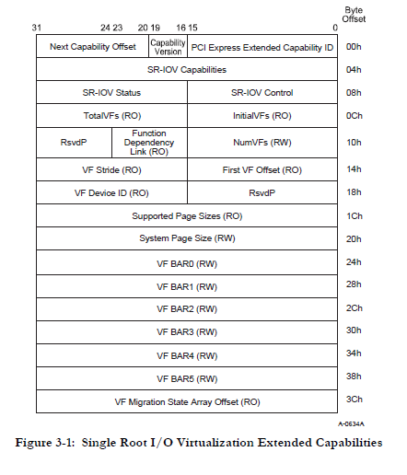
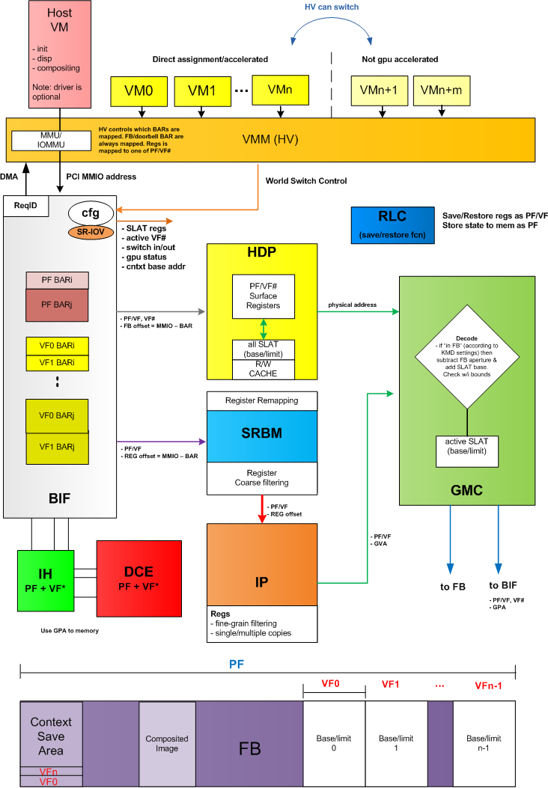
GPU Virtualization - Block DiagramS
Notes:
AA

Slide 45
Hypervisor Control – GPU-IOV CAPABILITY STRUCTURE
Notes:
45

Slide 46
GPU Virtualization - World Switch
If mapped,
unmap MMIO & flush the fabric
VM switch overhead V
context resume overhead R
engine 1
engine 2
switch-out instruction
engine 3
time
active
VM_{a}
fully operational
w/ multiple contexts
VM_{b}
fully operational
w/ multiple contexts
idle
engine 1 extra overhead
engine 2 extra overhead
switch-in instruction

Slide 47
Register Access
Register type
Registers access in PF or VF#
Same register name
Same register offset
VF# has register range subset
Register Type | Comment
HV only | GPU-IOV registers
PF only | GMC arbitration settings
PF or VF* | VM_CONTEXT[0-15]_PAGE_TABLE_BASE_ADDR
PF or VF*– RO | Any HW status register. Registers of this variety don’t need to be saved/restored
PF and VF* copy | MC_VM_FB_LOCATION
Notes:
47

Slide 48
SMU’s FW Loading
APU – load by SBIOS at boot up
dGPU – auto load during vBIOS post
Extra ROM space (around 256K) for SMU FW (and RLC_V and MC FW)
ROM interface
Detect ROM availability, read SMU FW
Side note : SMU FW has never changed after ASIC production
SMU expanded capability
Load other HW blocks’ FW
MC, CP (ME, PFP, CE), Compute, sDMA, RLC_V, RLC_G, DMIF
Driver
Upload FW to FB, notify SMU: FW type, location, size
SMU
Copy FW to local(internal) SMU memory
Authenticate FW - verification
Start loading FW, if:
No FW loaded before OR newer FW version
Before finish – Engine busy, no switch is allowed
Save authenticated FW
FW: backward compatible
Notes:
48

Slide 49
Agenda
HSA overview
Value proposition
Example use case – Viola-Jones face recognition method
Simple “HSA program” by yours truly
HSA bit and pieces
Software stack
User Queues + Memory Queue Descriptor(MQD) + Hardware Queue Description(HQD) + Doorbells
GFX ordering + coherency model
HSA Kaveri (GARLIC/ONION+) vs. Carrizo (ONION3)
IOMMUv2 feature set overview (memory translation, interrupt remapping)
ATS (and ATC/IOTLBs) overview
PCIe & OpenCL atomics
GPU HW Virtualization
SOC15 overview → another time maybe?

Slide 50
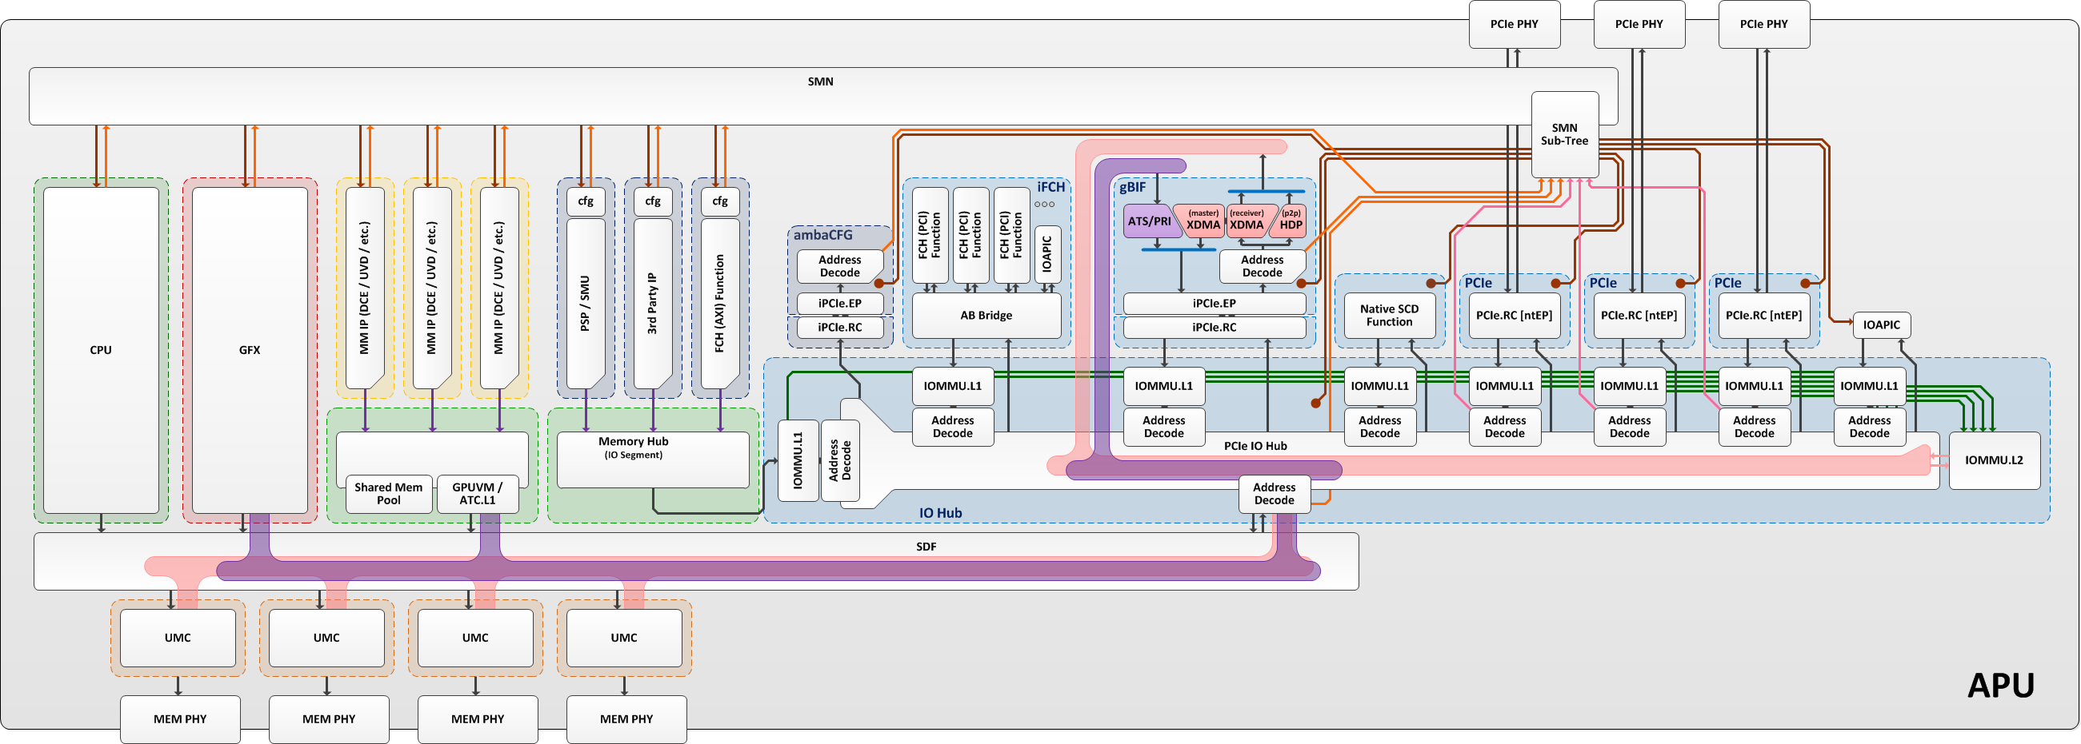
SOC15 – IO Complex Perspective
SCF (formerly SMN)
SDF
3rd party AMBA IP, eggplant, loop paths
AXI vs. SCD ports

Slide 51
BACKUPS

